Slide 1
Case Studies
IS465: Data Management and Governance

Slide 2
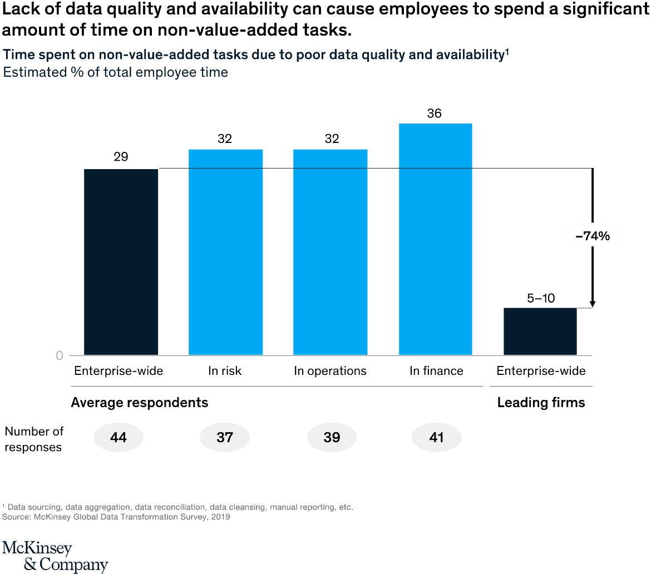
Designing data governance that delivers value

Slide 3
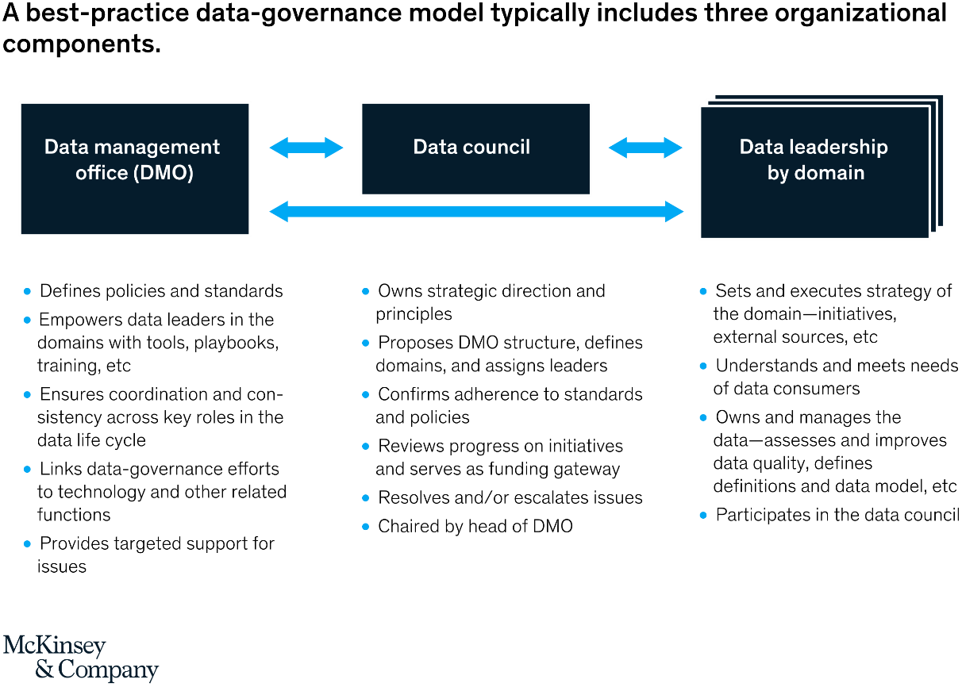
Designing data governance that delivers value

Slide 4
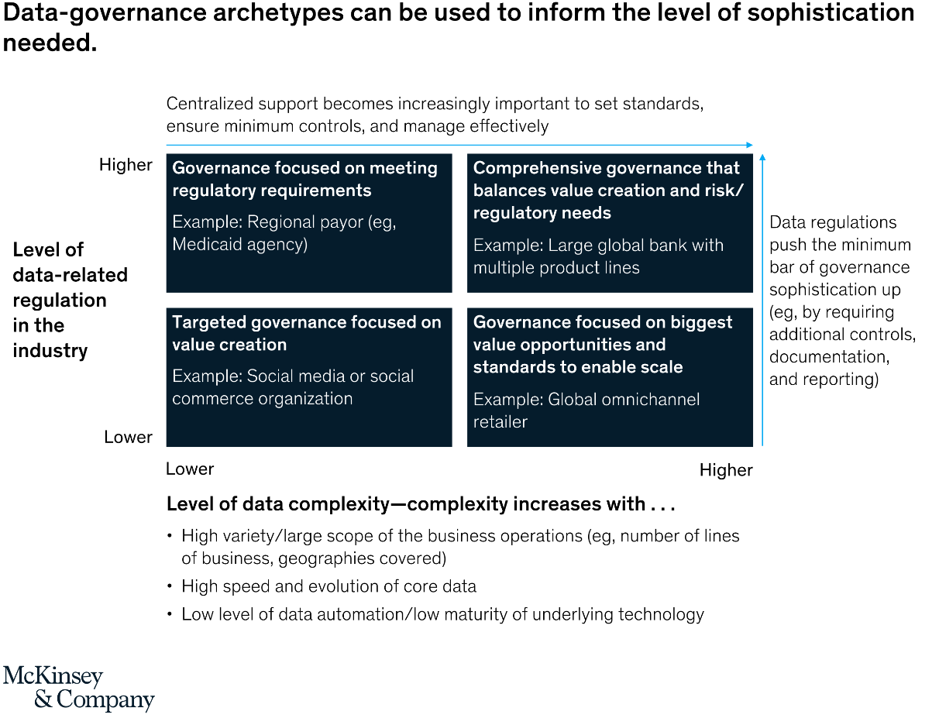
Designing data governance that delivers value

Slide 5
Uber set up a flexible approach to data governance
Uber operates in 70+ countries, each with its own data governance framework to comply with local and regional laws.
To ensure compliance across all regions,
Uses a core platform to take care of data privacy and security centrally.
Collects data globally but adapts its governance policies depending on the origins of each dataset by using customizations and plugins.

Slide 6
Uber set up a flexible approach to data governance
Manikandan Thangarathnam, the Senior Director of Mobility and Platforms at Uber, puts it:
“For example, a city or a country may have a rule by which they do not want to expose the driver’s name to the rider. So we have the capability to switch on or off depending on the city; we do not have to create a different application for that. That is the amount of engineering and flexibility that we have built into our system.”
The company has invested in training its people and honing their skills to ensure the success of its data governance programs across all regions.

Slide 7
How Wells Fargo built a single source of truth to ensure proper governance
Wells Fargo’s data governance strategy highlights the importance of creating a single source of truth to enhance data accuracy and reliability.
Their approach was to centralize data from multiple sources to create a unified, trustworthy source that reduced discrepancies and improved consistency.
This streamlined data management and allowed for more accurate reporting and analysis, thereby enhancing decision-making across the organization.

Slide 8
How Wells Fargo built a single source of truth to ensure proper governance
Prahalad Thota, the former Senior Vice President, Head of Enterprise Analytics & Data Science at Wells Fargo, describes their efforts:
“We established a team that brings data together and organizes it into our Enterprise Data League. The team focuses on establishing the right governance, in terms of storage and management, for the data. The team also focuses on leveraging data for driving cutting-edge use cases.”
Wells Fargo’s data governance strategy also emphasized the importance of data visualization (using Tableau) to make data more accessible to non-technical stakeholders and improve overall data literacy.
As a result, Wells Fargo was able to ensure data consistency, accuracy, and visualization to reduce risks and foster data-driven decision-making.

Slide 9
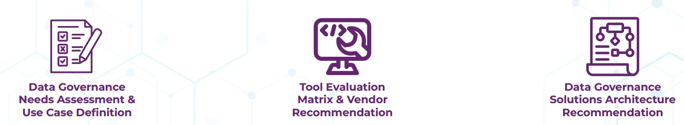
Benchmarking Data Governance Maturity
Project Background
A construction management firm was seeking:
An assessment of their data governance needs and advisory support for selecting a tool to address them.
To clearly define and prioritize their data management and governance use cases.

Slide 10
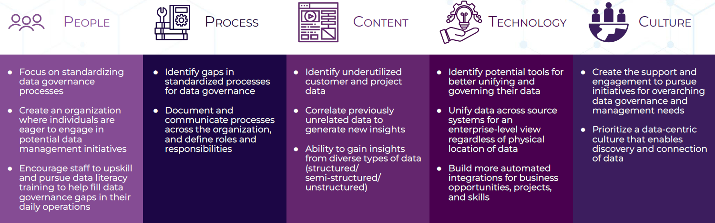
Data Governance Findings
Categorize key takeaways into five data governance themes.

Slide 11
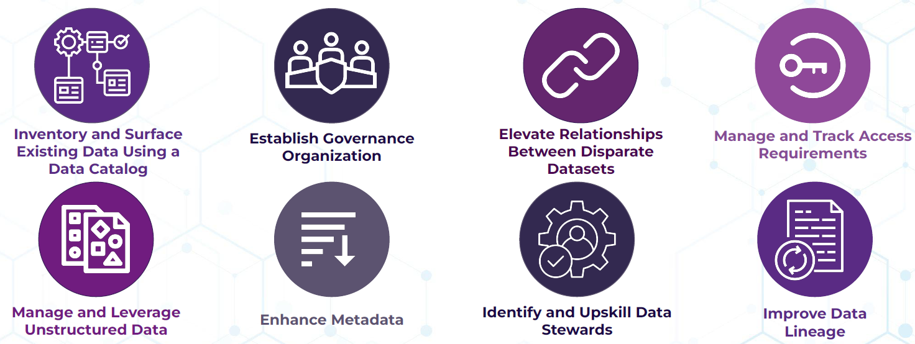
Priorities to Address Data Governance Challenges
A selection of recommendations.

Slide 12
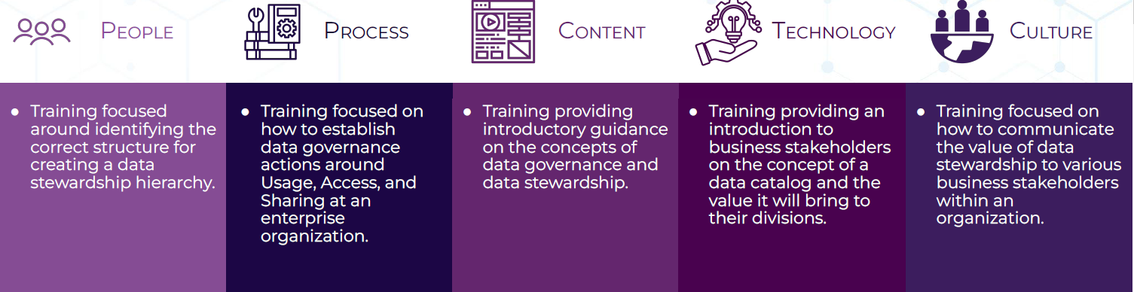
End User Training
Constructed a comprehensive training plan to upskill the organization in five key areas.

Slide 13
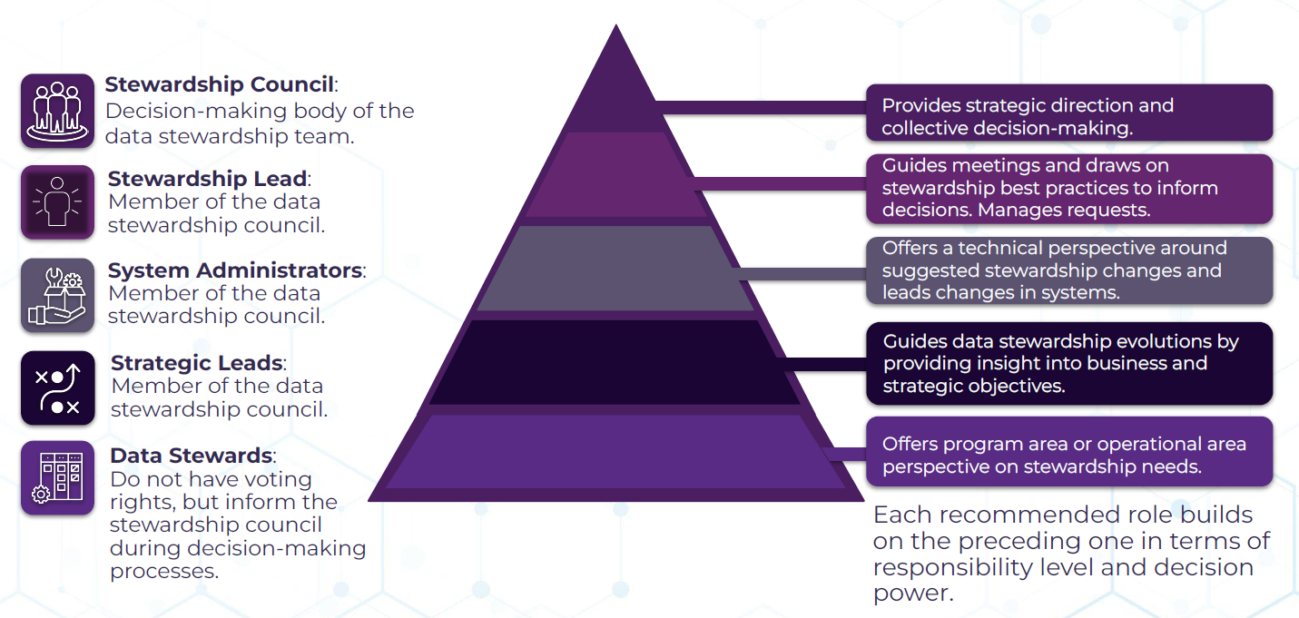
Data Stewardship Hierarchy

Slide 14
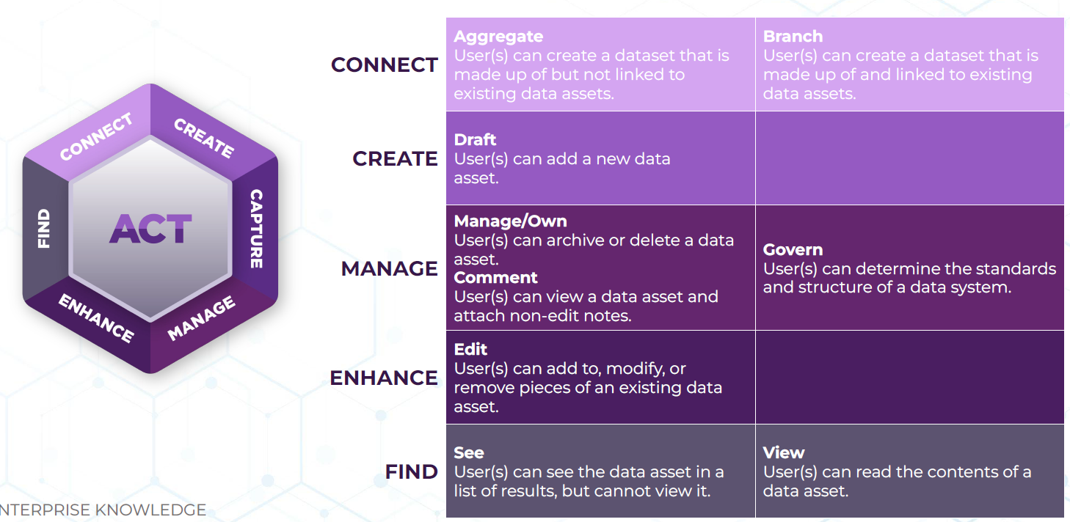

Access, Usage, and Sharing

Slide 15
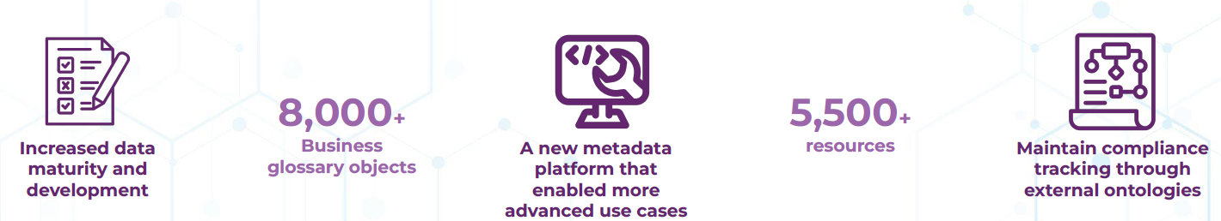
Tools and Frameworks
A multi-national financial organization was facing difficulties in unifying governance, discovery, and search across multiple metadata storage platforms within their global enterprise.
In order to rectify their existing data quality and governance issues with a standardized metadata platform, this organization identified a data catalog as a foundational solution to start addressing these challenges and consulted with us to lead the implementation.

Slide 16
Why is a Data Catalog Foundational?
A data catalog serves as a data governance tool that allows us to collect, aggregate, and present logical and physical metadata to end users.
A modern data catalog….
Contextualizes and enriches information with meaning of data based on business or data domains.
Establishes relationships across disparate data sources and across business and technical concepts.
Unifies unstructured and structured data to connect data of all formats.
Makes data and information easily searchable and discoverable.

Slide 17
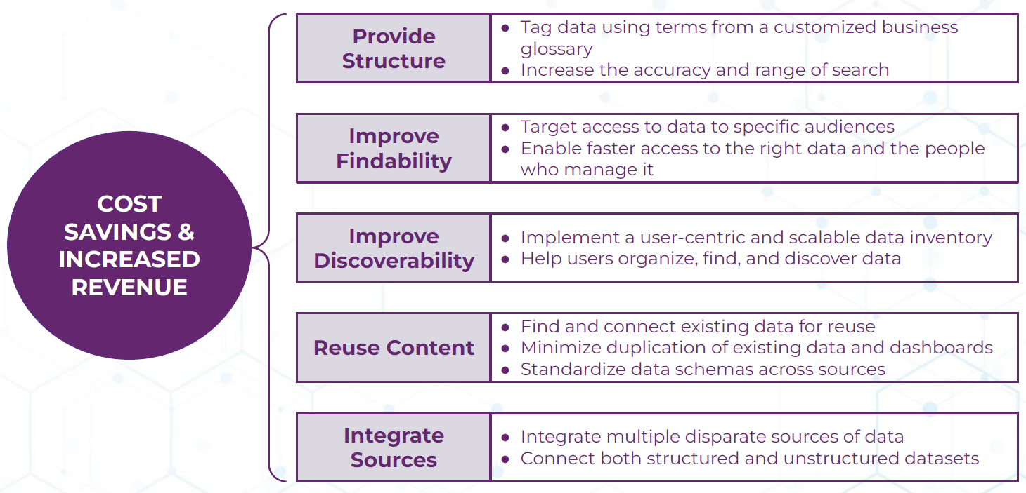
Data Catalog Business Value

Slide 18
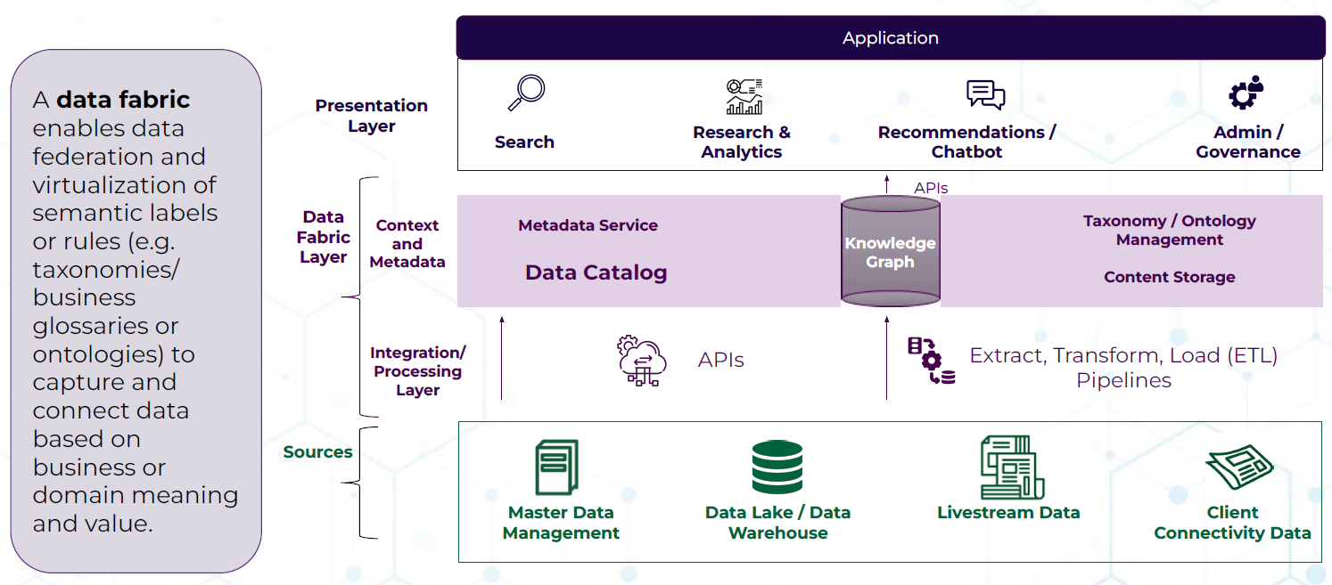
How a Data Catalog Fits into Data Governance Tools

Slide 19
GlobalBank
GlobalBank, a multinational banking corporation with operations in over 50 countries.
GlobalBank has experienced rapid growth in recent years, resulting in a significant increase in the volume and complexity of its data.
The company has multiple data systems, including customer relationship management (CRM) systems, transactional databases, and data warehouses.
However, the lack of a centralized data management strategy has led to data inconsistencies, inaccuracies, and security breaches.

Slide 20
Problem Statement
GlobalBank's CEO has mandated the implementation of a comprehensive data management and governance program to ensure the accuracy, security, and integrity of the company's data.
The program must address the following issues:
Data quality: Inconsistent and inaccurate customer data across different systems.
Data security: Recent security breaches have compromised sensitive customer information.
Data governance: Lack of clear policies and procedures for data management and use.
Data integration: Difficulty in integrating data from different systems and sources.

Slide 21
Case Study Solution
Data Governance Framework:
Established a Data Governance Council (DGC) comprising senior executives from different business units.
Defined data governance roles and responsibilities, including a Chief Data Officer (CDO).
Developed a data governance policy that outlines data management principles, standards, and procedures.
Established a data quality program to ensure data accuracy, completeness, and consistency.

Slide 22
Case Study Solution
Data Management System:
Designed and implemented a data warehouse to integrate data from different sources, including CRM systems, transactional databases, and external data sources.
Developed a data integration platform to ensure seamless data exchange between systems.
Implemented data quality checks and validation rules to ensure data accuracy and consistency.

Slide 23
Case Study Solution
Data Analysis and Visualization:
Developed a business intelligence (BI) platform to support data analysis and visualization.
Implemented data visualization tools, such as dashboards and reports, to support business decision-making.
Trained business users on data analysis and visualization techniques.

Slide 24
Case Study Solution
Policies and Procedures:
Developed policies and procedures for data management and use, including data access, storage, and retention.
Established a data breach response plan to ensure prompt response to security incidents.
Implemented training programs for employees on data management and governance best practices.

Slide 25
Benefits
Improved data quality and accuracy.
Enhanced data security and integrity.
Better decision-making through data analysis and visualization.
Increased efficiency and productivity through automated data integration and processing.
Compliance with regulatory requirements and industry standards.

